Slide 1
Emotions

Slide 2
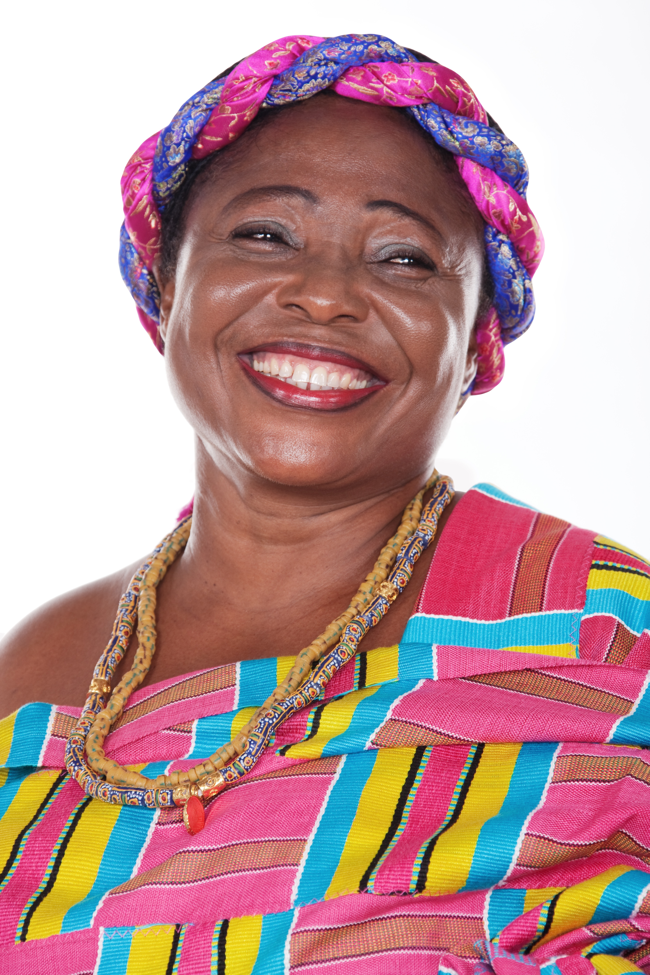
Happy

Slide 3
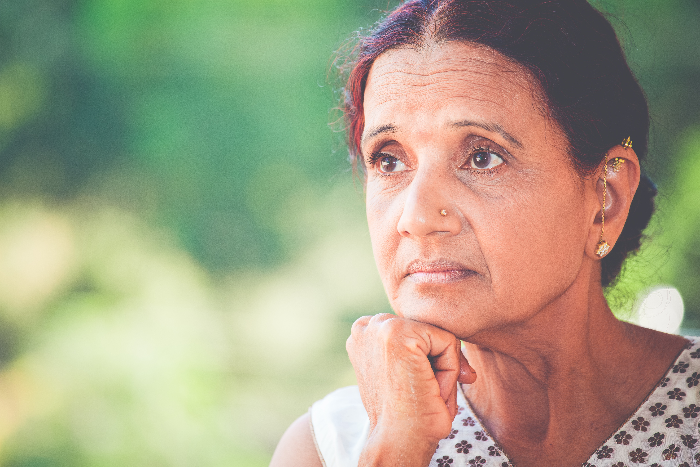
Sad

Slide 4
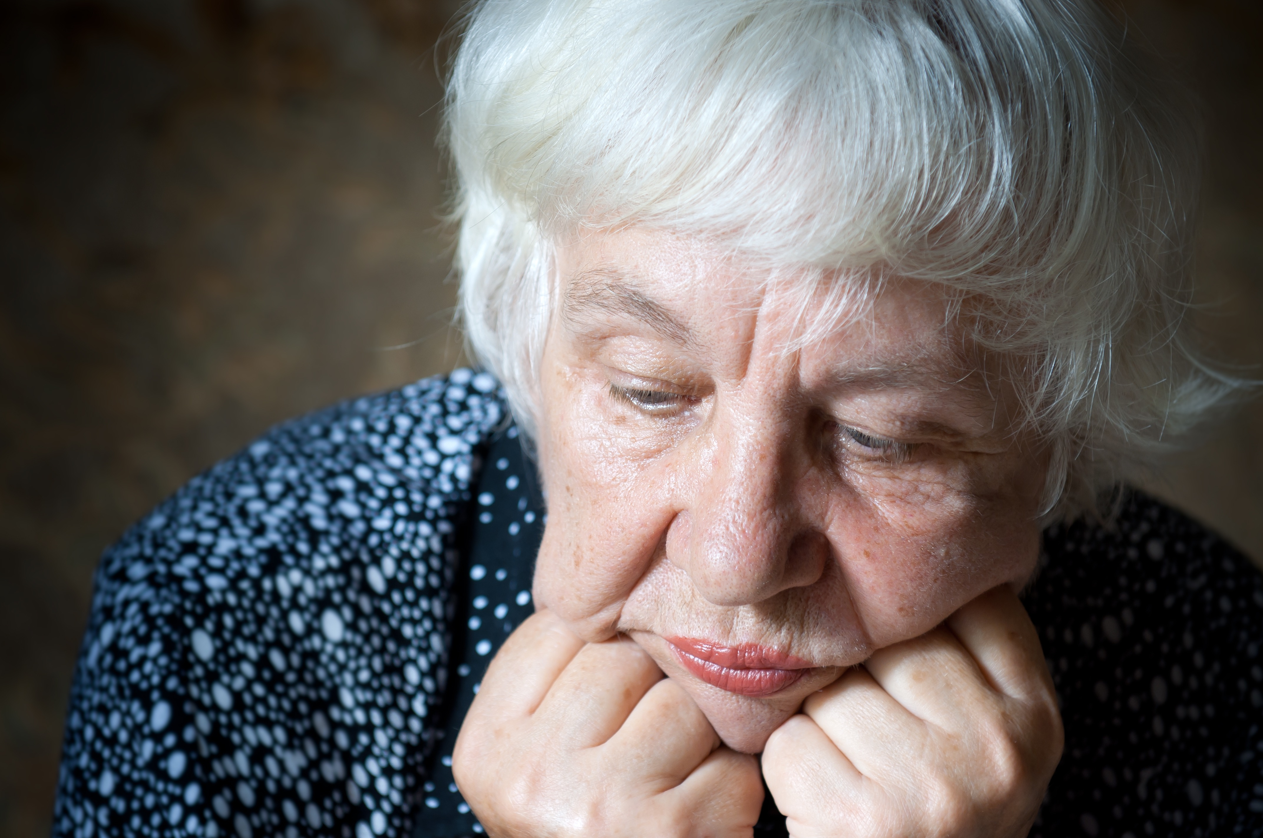
Depressed

Slide 5
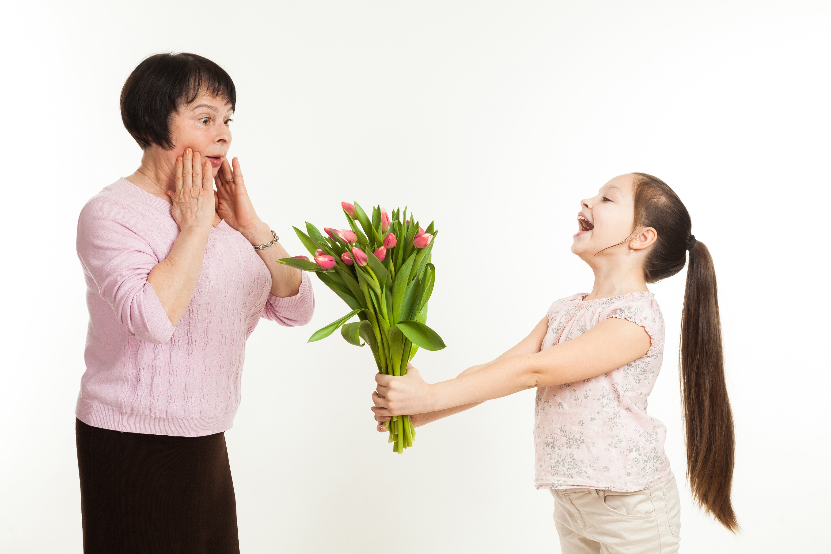
Surprised

Slide 6
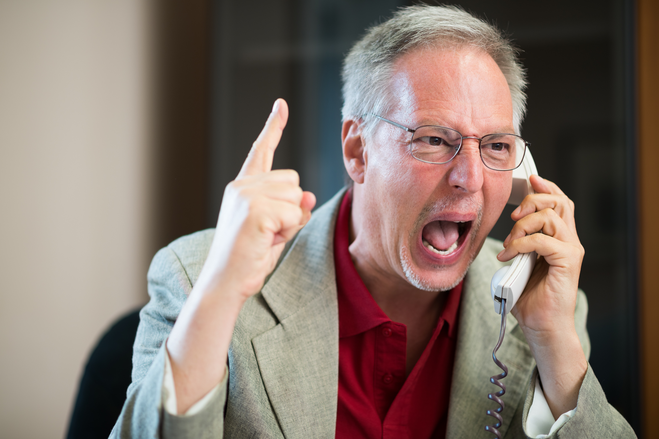
Angry

Slide 7
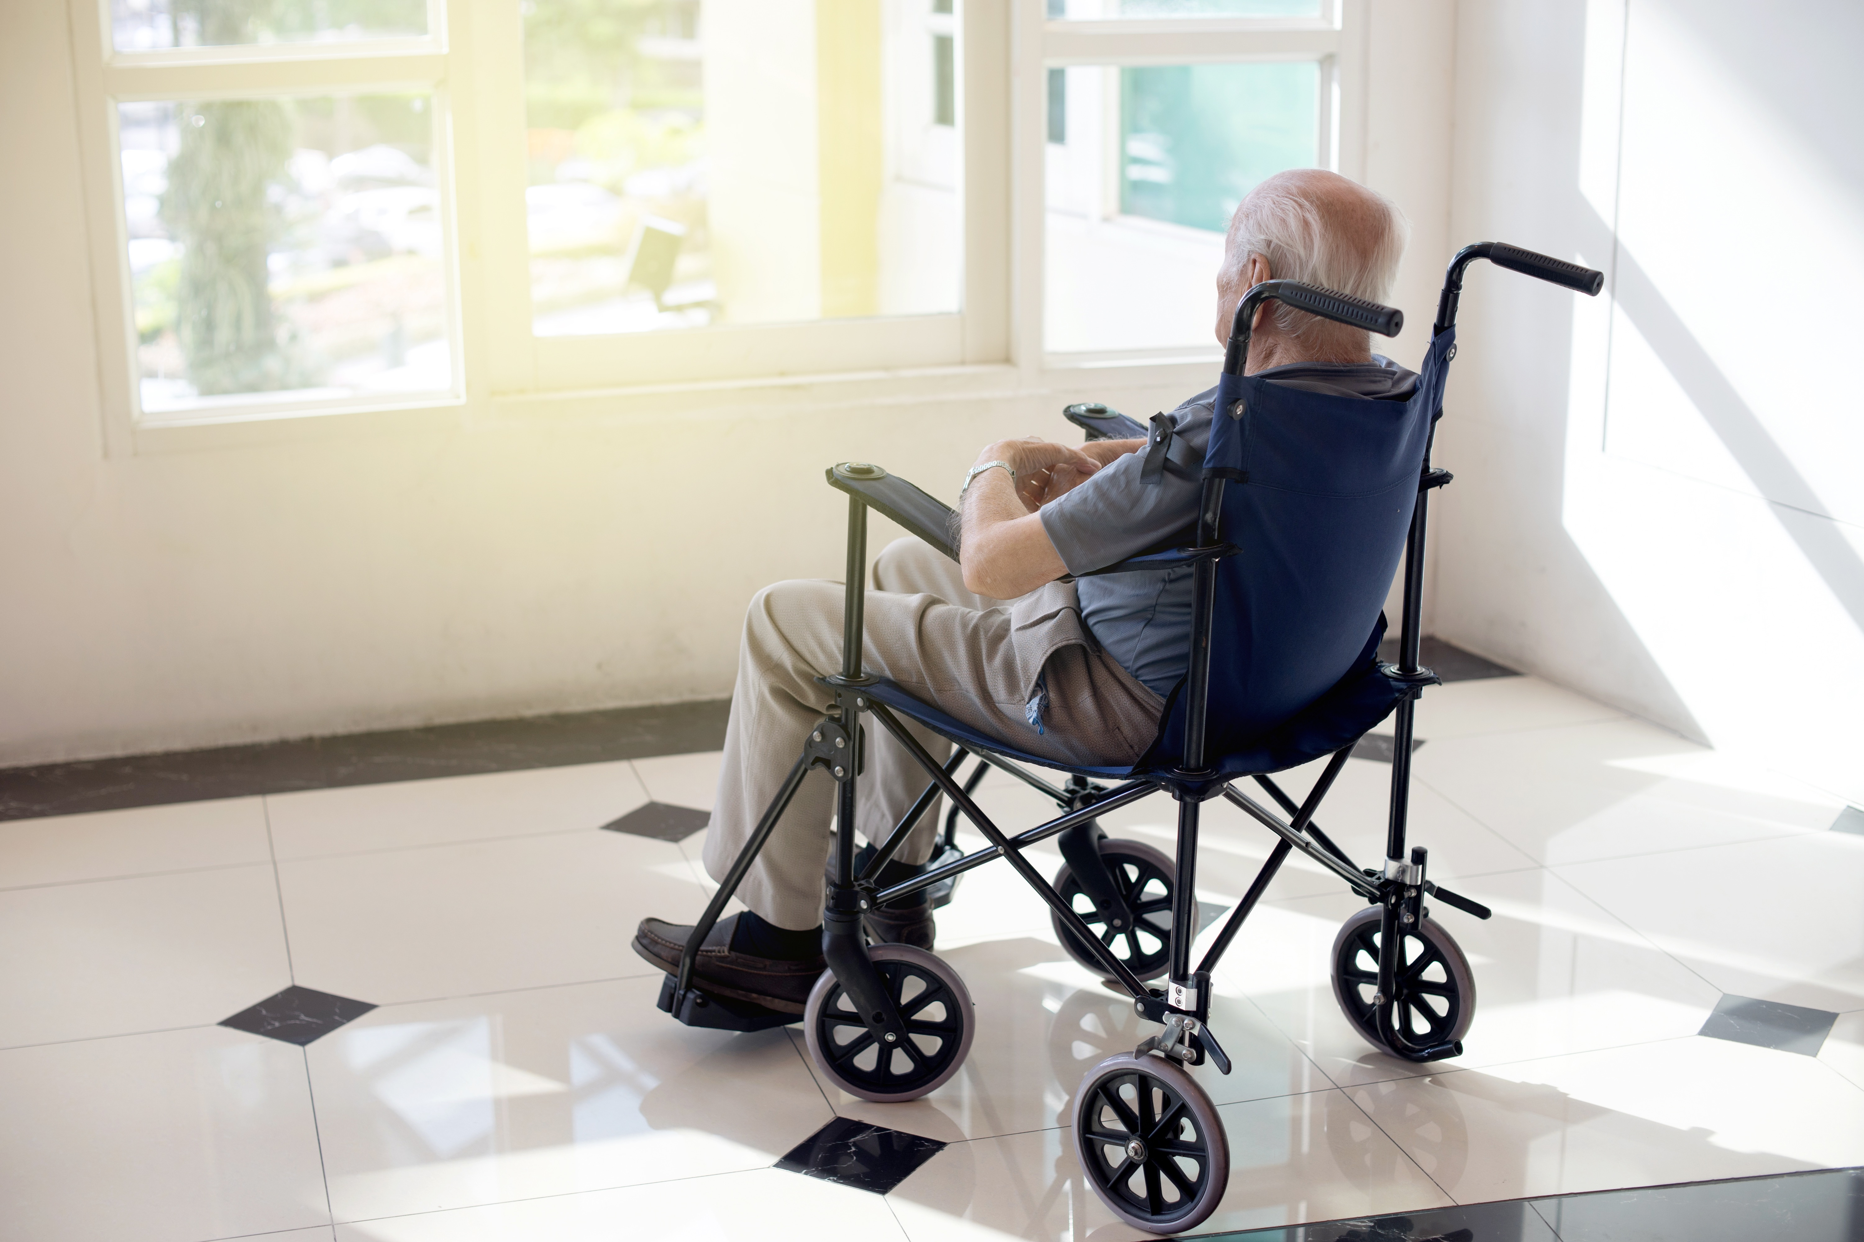
Lonely

Slide 8
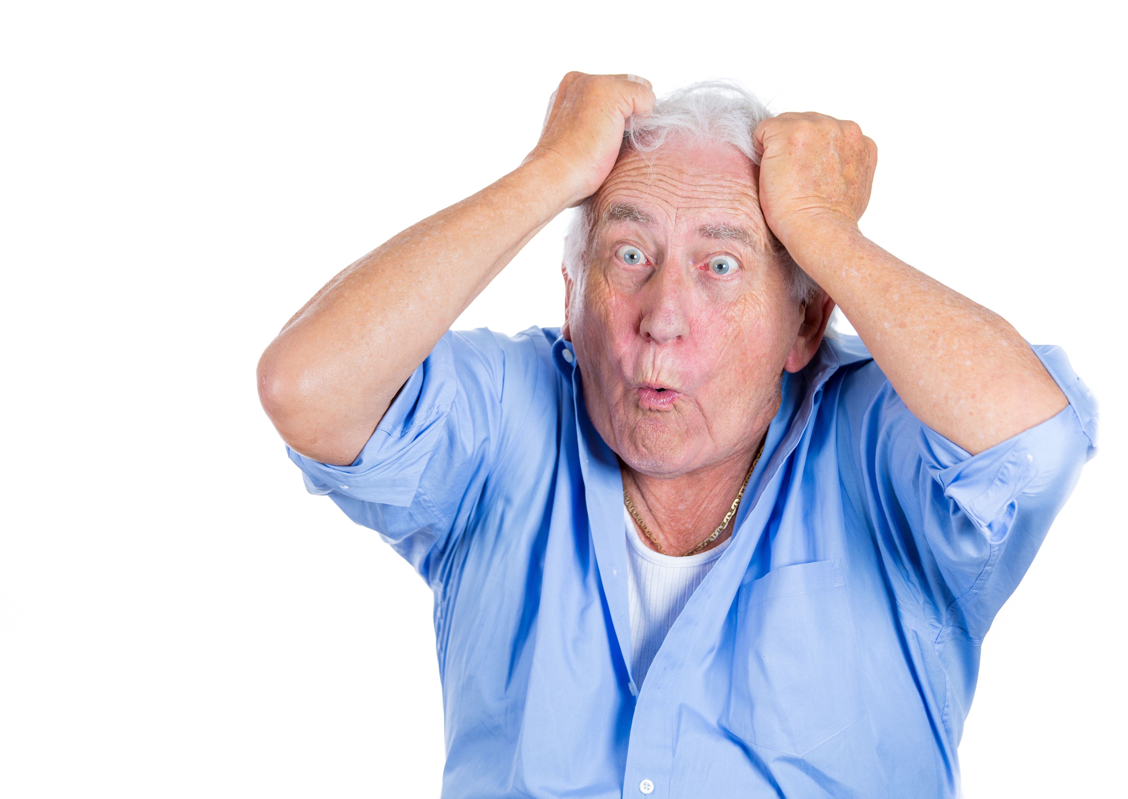
Frustrated

Slide 9
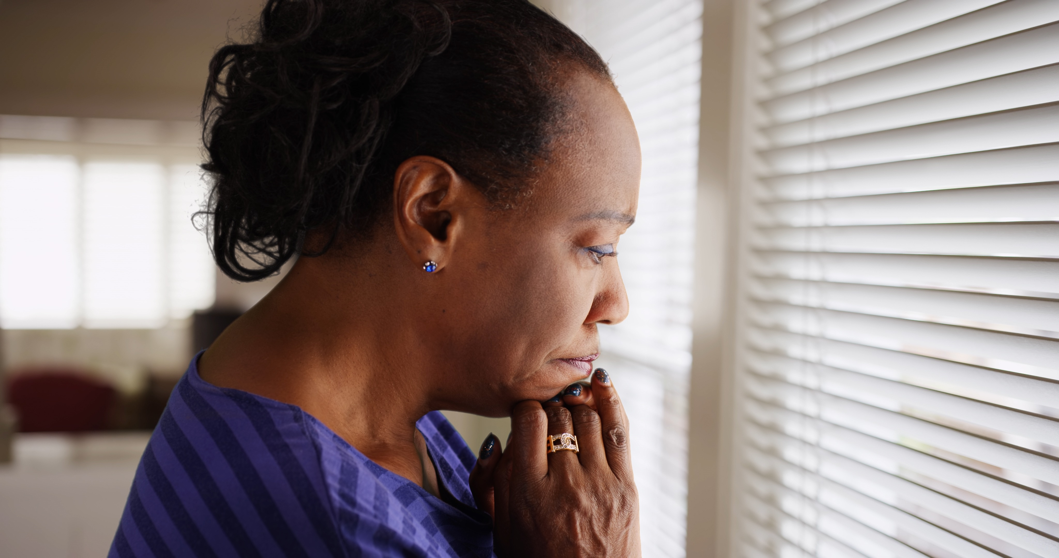
Anxious or Worried

Slide 10
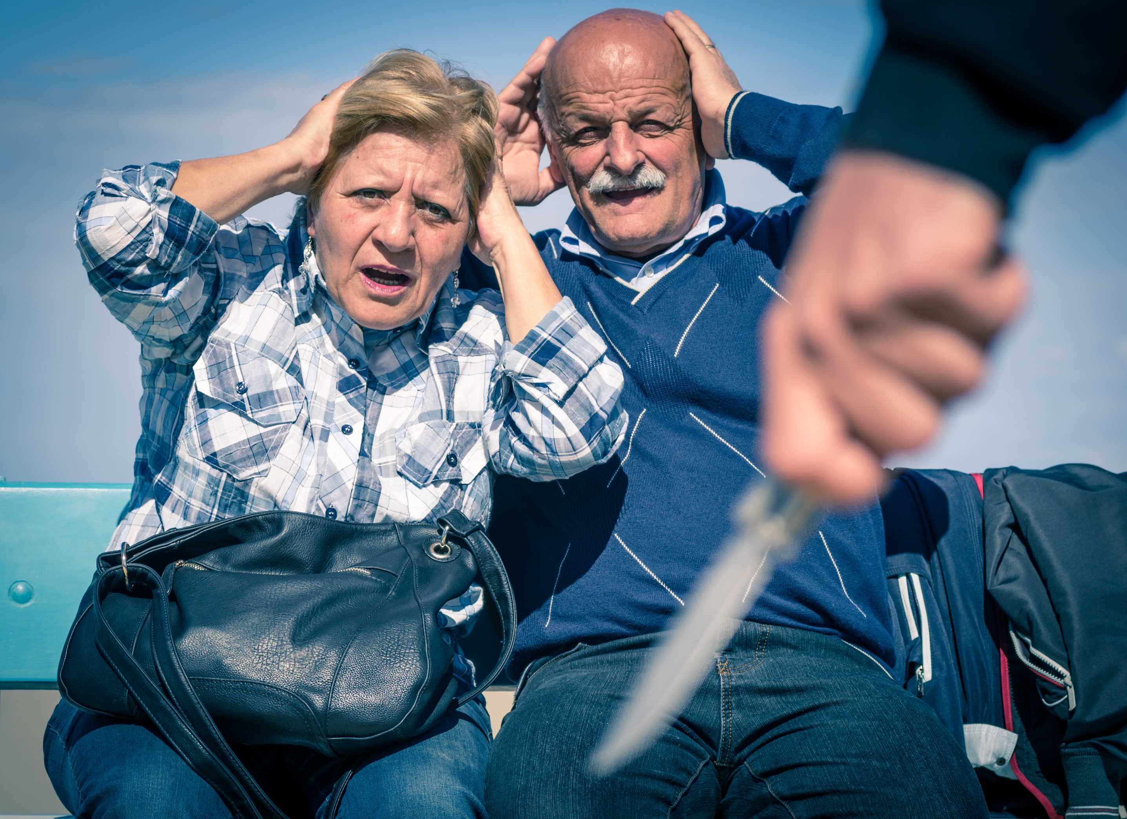
Afraid or Frightened

Slide 11
How are you today?
I’m happy because______.
I’m sad
because_______.
That’s great!
I’m sorry
Congratulations!
That’s too bad.
I am happy
for you!
Can I
help you?

