Slide 1
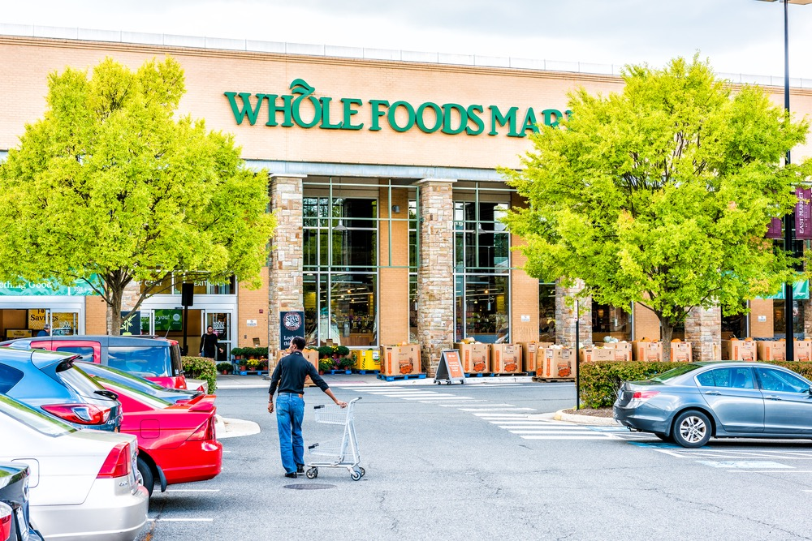
Let’s Learn Words About Grocery Shopping!

Slide 2
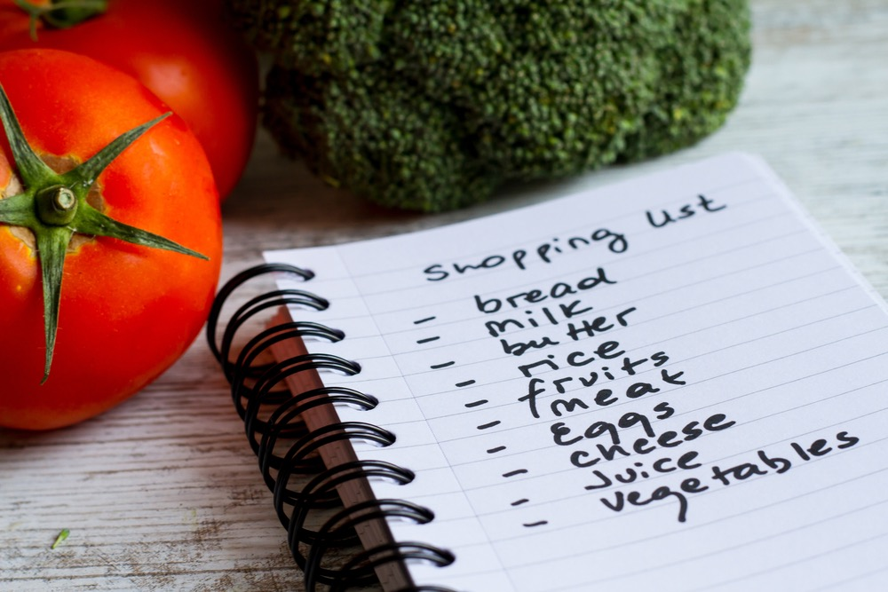
Shopping List

Slide 3
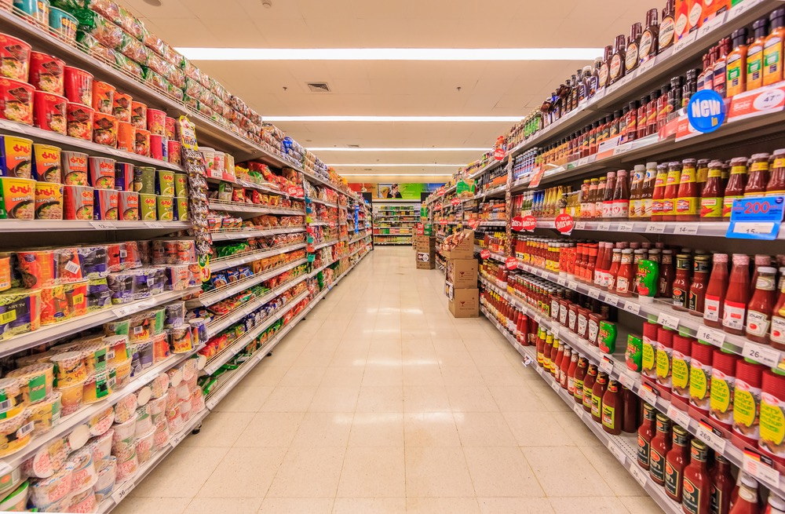
Aisle
Bottom Shelf Top Shelf

Slide 4
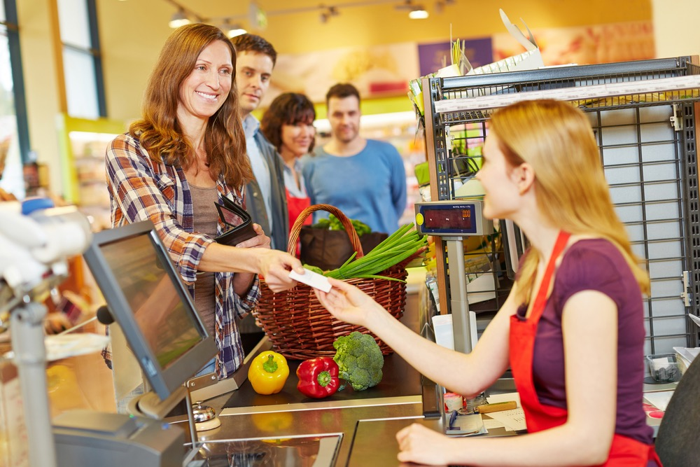
Cashier

Slide 5
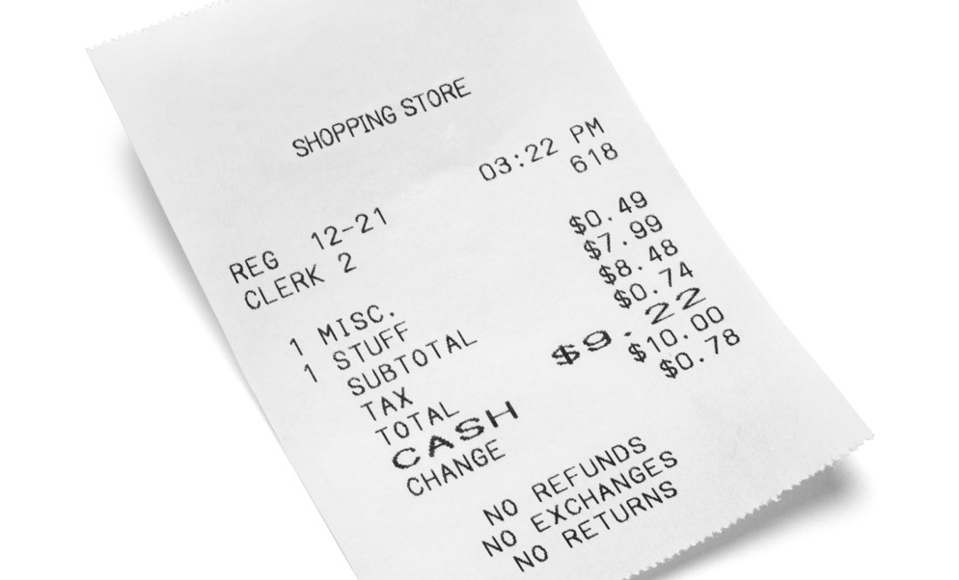
Receipt

Slide 6
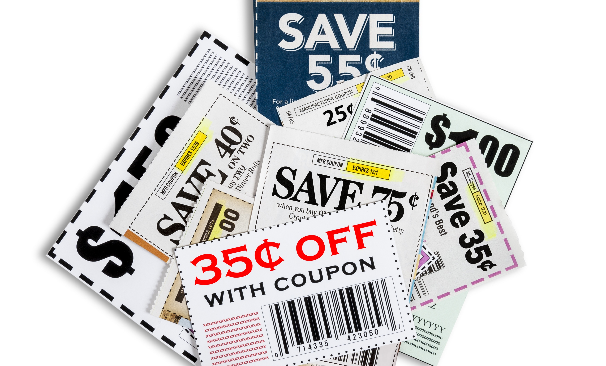
Coupons

Slide 7
Pound (LB)

Slide 8
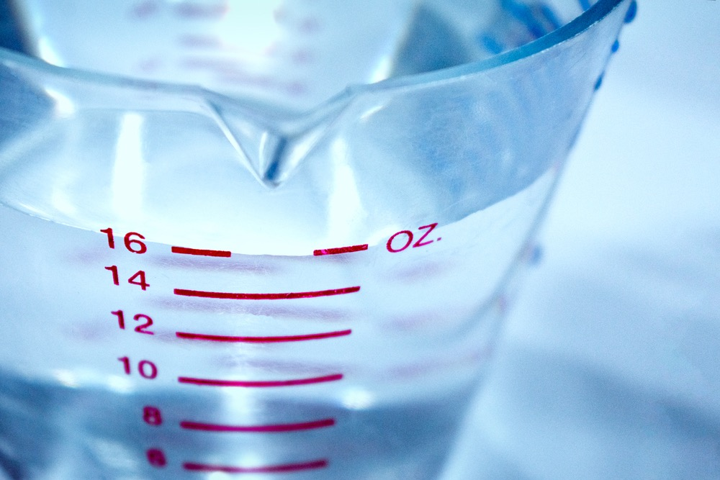
Ounces (OZ)

Slide 9
Each (EA)

Slide 10
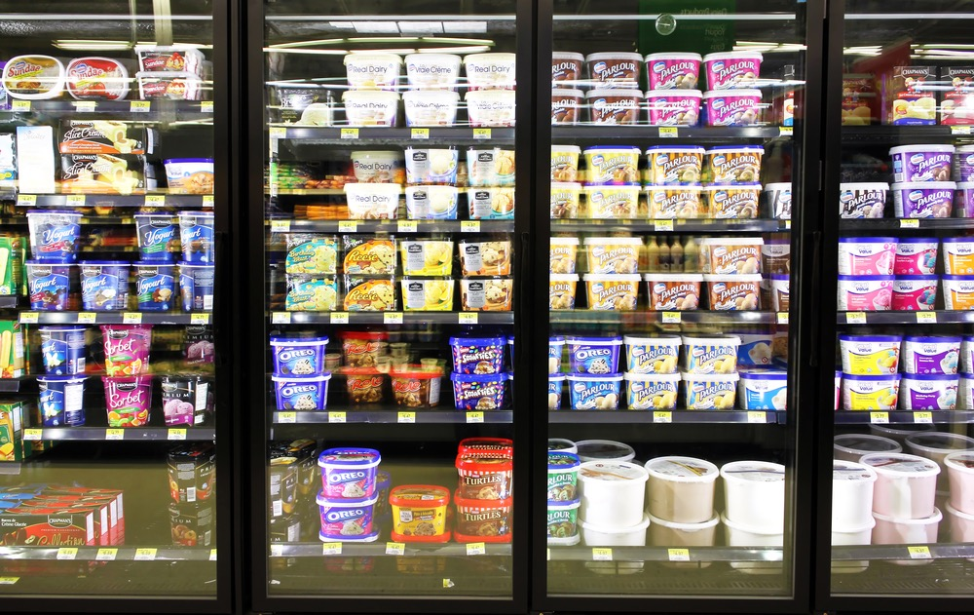
Frozen Foods Section

Slide 11
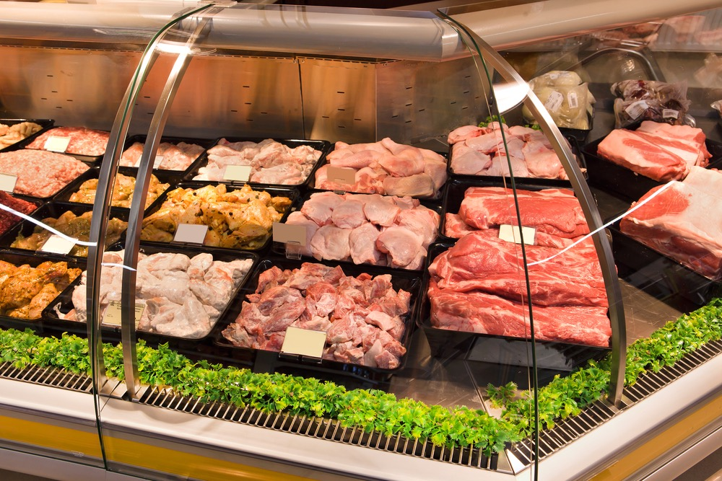
Meat Department

Slide 12
Bakery

Slide 13
Dairy Section

Slide 14
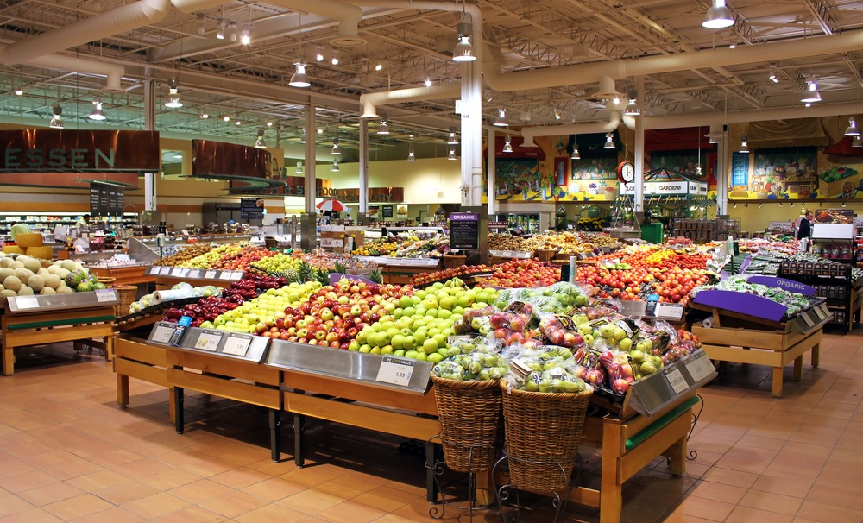
Produce
Fruits and Vegetables

Slide 15
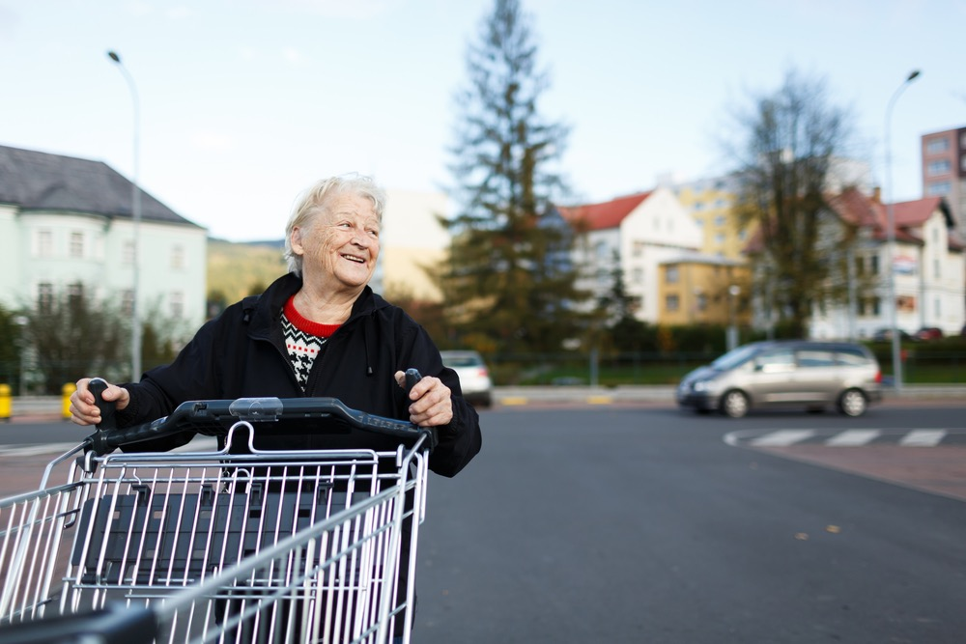
Shopping Cart

